Slide 1

CPSC 8740 Final Project: ETAGlance
Rahul Chamarthi

Slide 2
Table of Contents
Introduction
Project Plan
AI Tool Setup & Summary
User Interface Design and Integration
Testing and Refinement
Challenges
Conclusions & Future Work

Slide 3
Introduction: Why and What is ETAGlance?
Why?
The idea for this application has been in my head for quite sometime
As a Graduate Student that is also working as a Consultant full time, I often struggling to be on time
The current maps applications in iOS do not allow you to pin ETAs to locations on your lockscreen
What?
The simple idea behind this app was to create a sleek, minimalist iOS app that would allow users to track ETAs to their favorite locations
Satisfaction of the core objective would depend on a widget that could be pinned on a User’s Home Screen or Lock Screen

Slide 4
Project Plan
Red labels indicate objectives I was unable to complete due to getting sick at the beginning of Week 4
Week | Theme | Milestones | Deliverables
Week 1: 11/5 – 11/11 | Foundations | Define problem scope & requirements Design Initial Architecture UI exploration via Figma and Stitch Set up Xcode Project Structure | Project created Folder structure initialized FavoriteLocation model HomeView scaffold with mock location cards Initial floating “+” button to Add Favorite Location
Week 2: 11/12 – 11/18 | Interactivity & State | Enabled user-driven functionality Added ”Add Favorite Location” UI Flow Built persistent state management | AddFavoriteView Multi-select transport modes JSON persistence to save/load locations Swipe-to-delete added
Week 3: 11/19 – 11/25 | Location, MapKit, Widget and Identity | Integrated real-world data Built ETA engine with MapKit Created WidgetKit extension Added user identity/sign-in system | LocationService RoutingService Fastest-mode ETA selection Widget implemented User profile persistence
Week 4: 11/26 – 12/5 | Stability, Testing, MVP | Completed ”Edit Favorite Location” UI Flow Performed Stress Testing & Bug Fixing Polished UI + Widget Layout | EditFavoriteView fully implemented Polish Widget Unit Tests

Slide 5
AI Tool Setup & Summary
Category | Tool/Library | Reason for Selection & Challenges
Coding & IDE | Cursor | Selection: AI context awareness sped up Swift coding Challenge: AI sometimes suggested deprecated syntax that required debugging in Xcode, and create issues with compiling UI.
Design | Stitch | Selection: Enabled rapid creation of UI wireframes and icon assets for both App and Widget formats. Challenge: Had to go through using multiple AI Tools; Stitch, Figma and Galileo to hone on one that balanced ability with usability.
Environment | Xcode | Selection: Required for iOS Build System Challenge: Configuring “App Groups” so the Widget and App could share the same location database, and the learning curve associated with modern iOS development.
Libraries | CoreLocation & WidgetKit | Selection: Essential for GPS tracking and Home Screen updates. Challenge: Handling privacy permissions and background refresh limits.

Slide 6
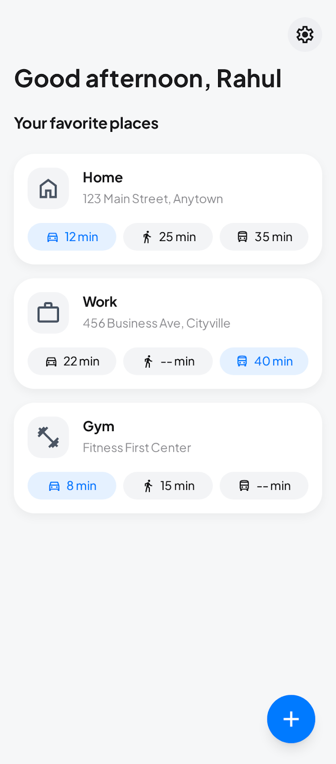
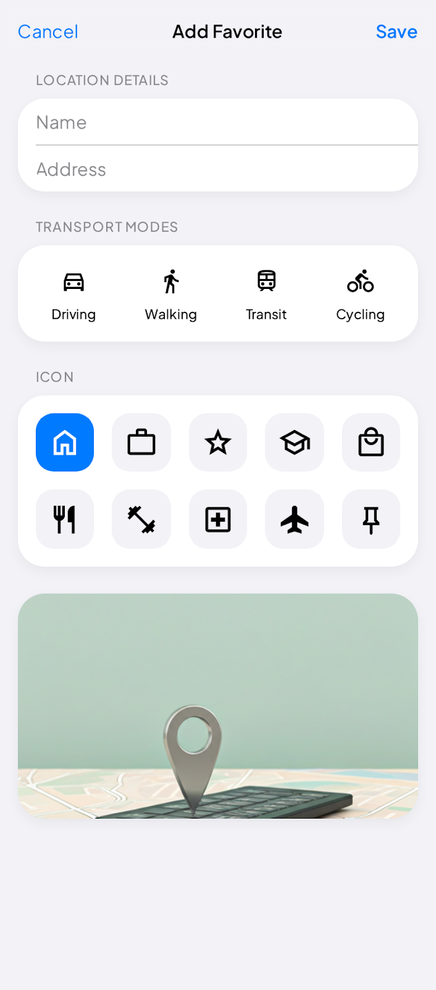
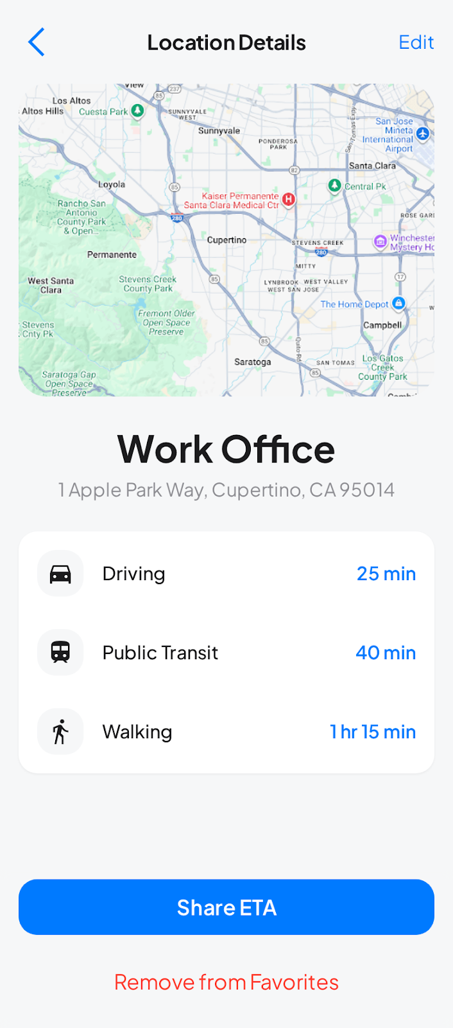

UI Design, Wireframes & Prototypes
Design Workflow:
Used Stitch to rapidly generate and refine UI layouts
Started with low-fidelity wireframes to define navigation flow and screen hierarchy
Evolved into high-fidelity prototypes that matched modern iOS design patterns (cards, SF Symbols, segmented controls)
Wireframe & Prototype Quality:
Captured the complete app flow: Home (HomeView) -> Add/Edit (AddFavoriteView/EditFavoriteView) -> Widget (ETAWidget)
Design focused on clarity, minimalism and quick glanceability
Widget prototypes followed WidgetKit layout constraints and matched Apple’s visual language
Wireframes generated by Stitch
Home (HomeView)
Add Favorite (AddFavoriteView)
Edit Favorite (EditFavoriteView)
Widget (ETAWidget)

Slide 7
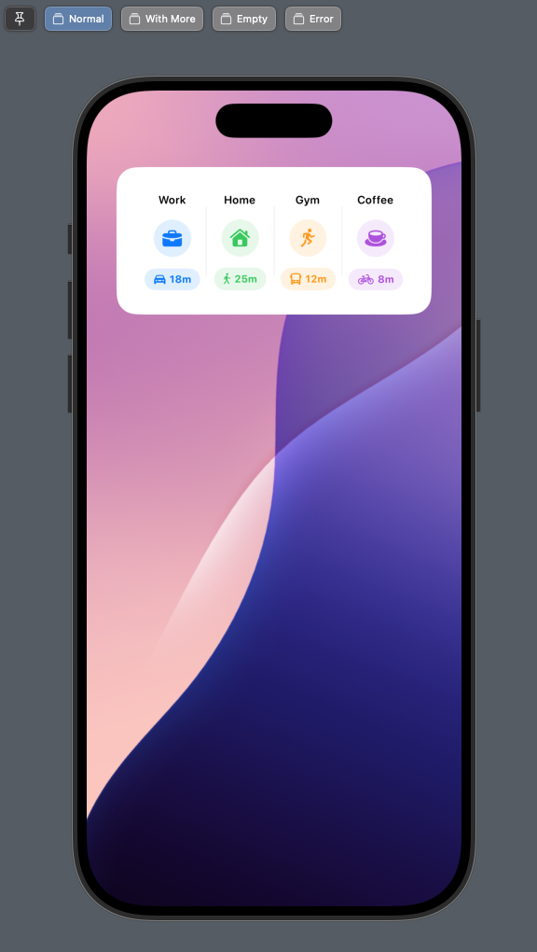
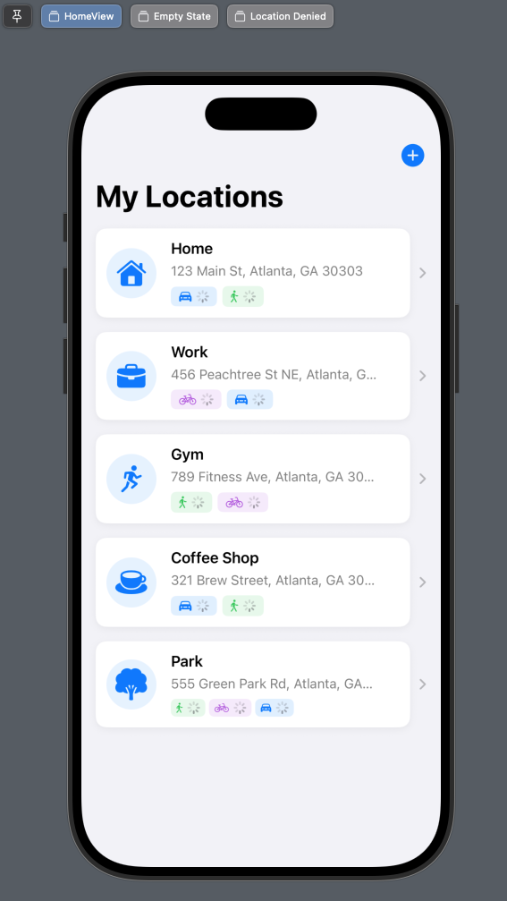
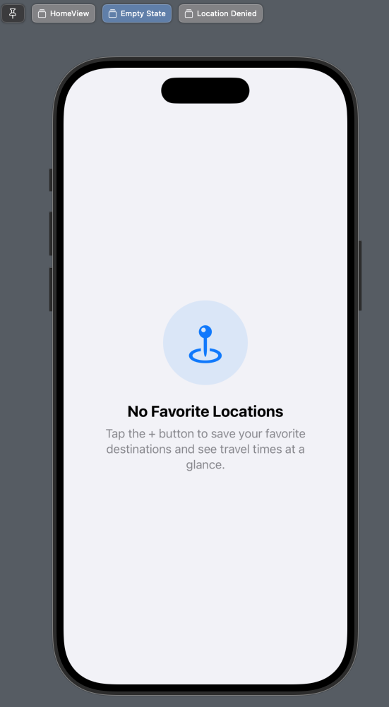
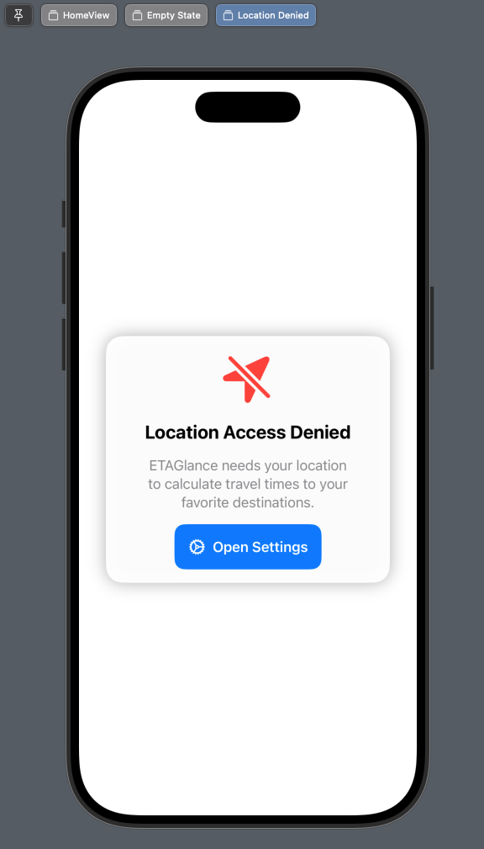
UI Integration, Functionality and Usability
UI Integration:
Connected Stitch-generated SwiftUI components to live data using @StateObject and @EnvironmentObject
Unified app styling across views and widget (consistent spacing, colors, corner radii, iconography)
Integrated Home, Add, and Edit views directly with persistence, routing, and location services.
Functionality & Usability:
Card-based Home screen allows quick scanning of ETAs for each destination .
Add/Edit flows emphasize speed: simple inputs, icon grid, multi-modal transport selection.
Widget presents the four key ETAs in a compact easy-to-read layout
Smooth handling of errors (location denied, network issues, routing failures)
Real Images from Xcode showing translation of Wireframes from Stitch

Slide 8
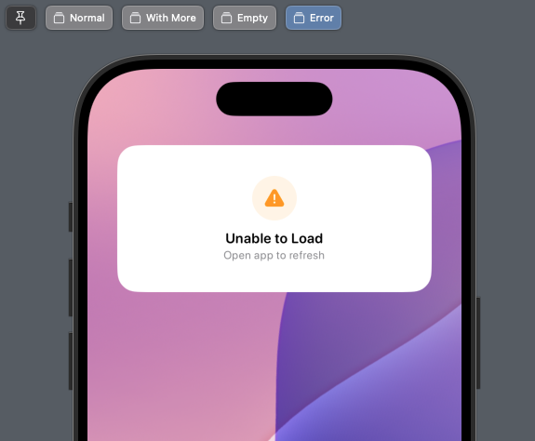
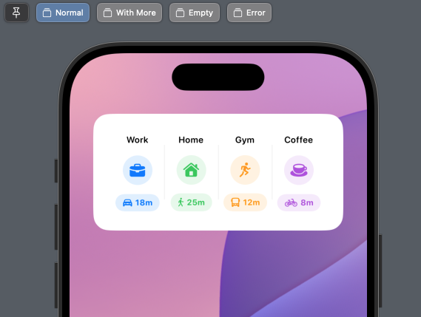
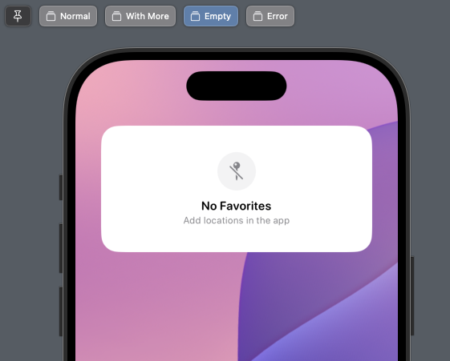
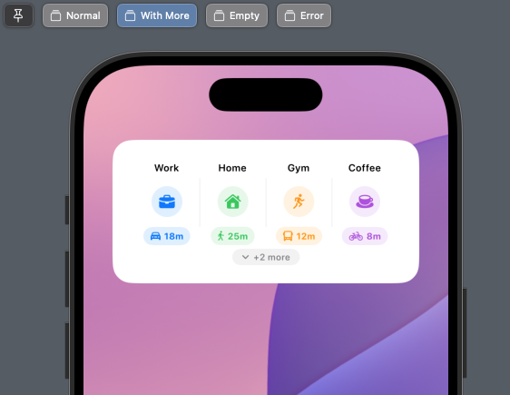
Testing and Refinement
Usability Testing Process:
Performed iterative manual testing across HomeView, Add/Edit flows, and widget behavior
Tested under different network conditions and simulated location states to verify proper ETA times loading
Collected informal peer feedback on clarity of ETAs, icon selection and navigation flow from Software Engineering friends
Bug Fixing & Iterations:
Refined ETA formatting and color coding after multiple rounds of debugging when ETAs appeared inconsistent or visually misaligned
Fixed routing failures by adding retry logic and adjusting when ETAs refresh
Limitations:
Became ill near the end of the sprint, preventing completion of planned unit test coverage
Despite this, extensive manual and scenario-based testing resulted in a stable MVP
Example of error-handling and multiple views for widget to handle failure cases following testing

Slide 9
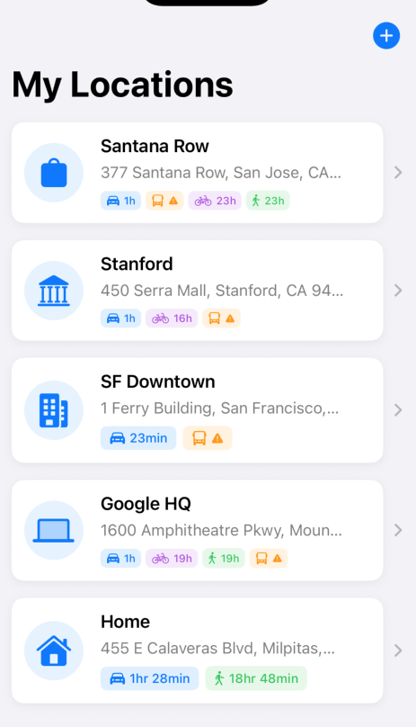
Challenges
Technical Constraints:
Transit ETA limitations: Apple MapKit only supports transit-mode ETAs in select cities. The app required a fallback mechanism and caution flag since transit results were inconsistent or unavailable in some regions
Widget data constraints: Sharing live ETA data through App Groups requires careful timing and fallback states, had to leave this out of the MVP due to time constraints
Development Challenges:
Illness during final sprint reduced development time, preventing completion of planned unit testing, delaying non-core features and submission to the App Store
User Profile system (sign-in and profile editing) was scoped but not fully implemented due to time constraints
UI & Interaction Challenges:
Achieving consistent ETA formatting, color coding and alignment required several iterative refinements as real MapKit data revealed edge cases
Final MVP showing Transit loading issues

Slide 10
Conclusions & Future Work
Conclusions:
Successfully developed a functional iOS ETA application integrating MapKit routing, persistent favorites, multi-modal travel times, and a production-ready widget
Demonstrated the effectiveness of AI-assisted tools (Stitch and Cursor) to accelerate UI prototyping, integration and development
Iterative testing and refinement produced a stable, intuitive interface that supports quick glance decision making
Future Work:
Implement full unit test coverage (RoutingService mocks, persistence tests, widget timeline validation)
Implement User Profile System and Cloud Synchronization for multi-device support
Enhance routing engine with real-time traffic weighting, better fallbacks for unsupported transit regions, and caching strategies for faster loading
Add advanced features such as calendar-based ETA predictions
Submit to App Store

